Slide 1



Technical Writer Test - Publishing a Collateral
January, 2021

Slide 2
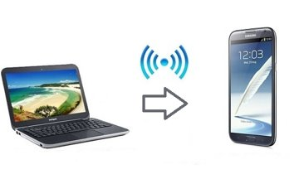
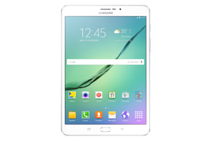
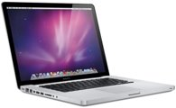
Introduction
mSeries™ lets back office users publish and control content sent to field users in a simple and direct way. Back office teams have all the necessary tools to establishing the target audience, the validity period of the document being shared and even monitoring how often the file is accessed. Thus, mobile users have access to up-to-date content when and where they need it.

Slide 3
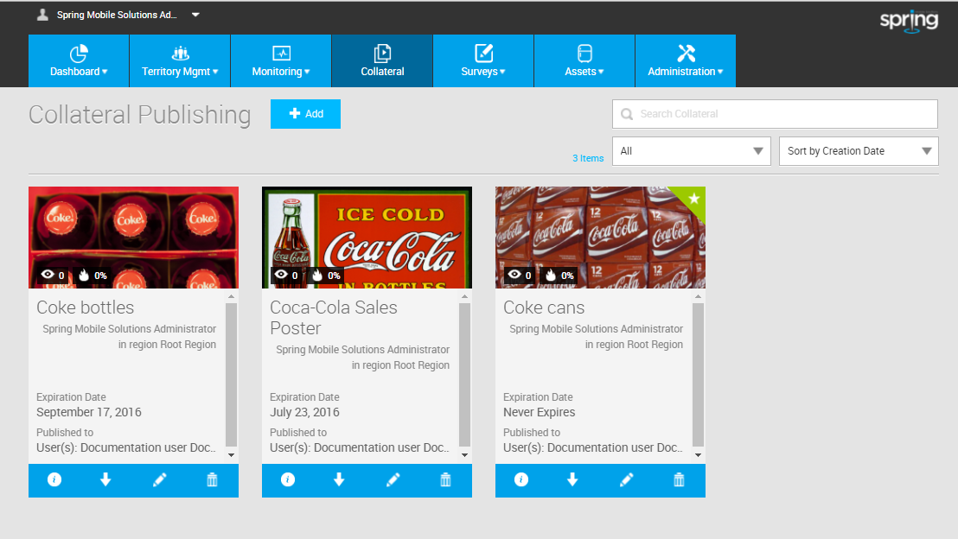
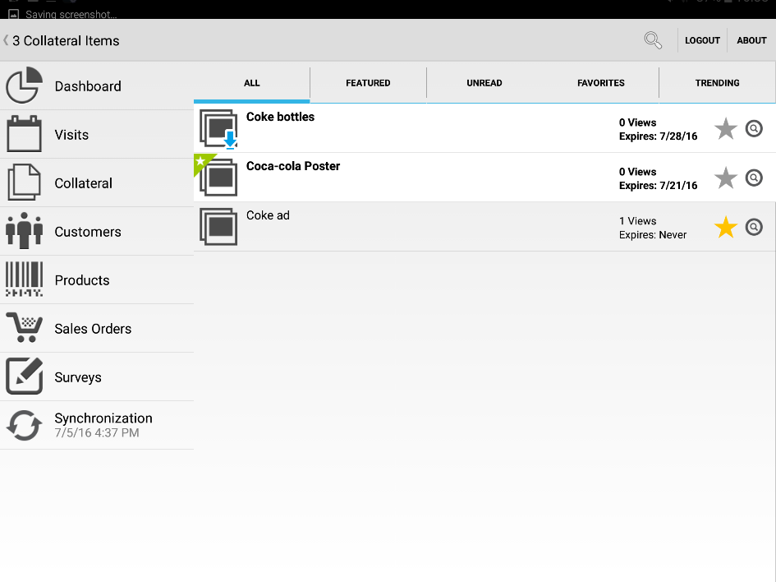
What is the mSeries™ Collateral module?
Collateral, in marketing and sales, is the collection of materials used during the sale and distribution of a product - like brochures, folders, etc. The Collateral module allows publishing documents directly to field users (Example: all users from region X receive a specific collateral) or indirectly to users (Example: all users who visit customer X receive a specific collateral).
Back office (Web Portal)
Field User (Mobile app)

Slide 4
Publishing collaterals
Step 1 – Click the “+Add” button to start publishing.

Slide 5
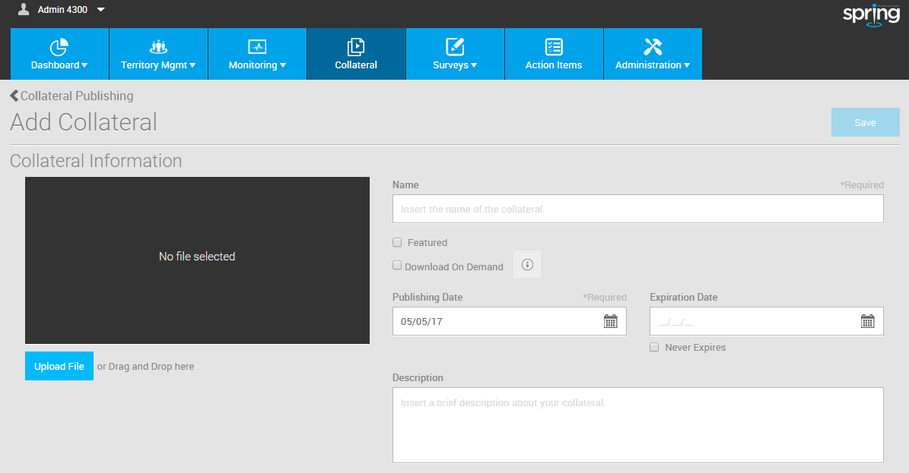
Publishing collaterals
Step 2 – Upload your file:
Click “Upload File” at the bottom of the page. You can also drag or drop a file.

Slide 6
Publishing collaterals
Step 3 – Fill out the form:
Complete form filling by clicking a text field and typing. You can add a checkmark if it never expires.

Slide 7
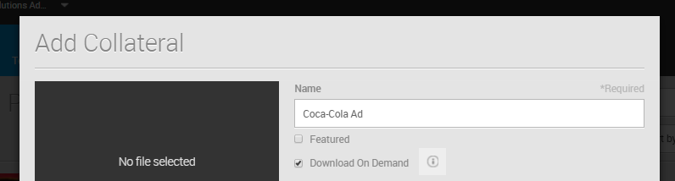
Publishing collaterals
Step 4 – Check the “Download On Demand" checkbox.

Slide 8
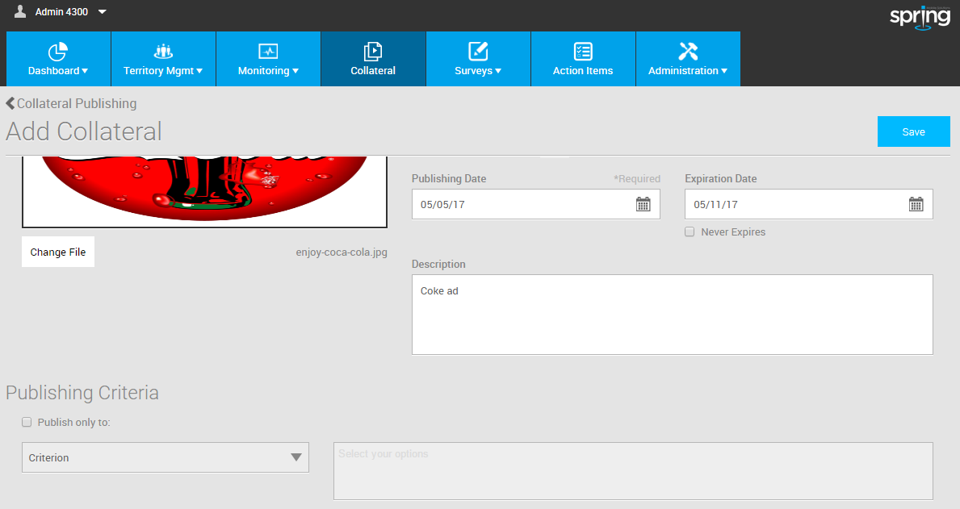
Publishing collaterals
Step 5 – Publishing Criteria:
Check the “Publish only to” checkbox to start

Slide 9
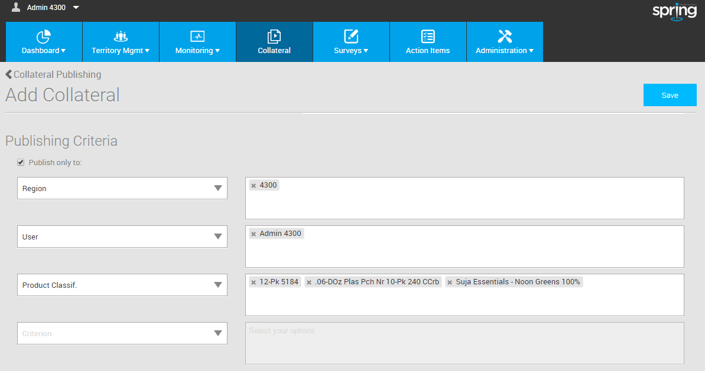
Publishing collaterals
Step 6 – In the select boxes you can choose the Region, User and Product Classification, then enter data in the respective fields. You should hit the enter button to separate each information.

Slide 10
Publishing collaterals
Step 7 – Send your form:
After you have filled the form, save it by clicking on “Save” at the top of the page.

